Slide 1
Parameters (base model) AIC = 547.12 -LogLik = 273.56
Abbrev | Symbol | Full parameter name (fix or potentially estimate*) | Initial (or fitted) value
delM | δ_{M} | Shape corrector (fix) | 0.1066
dV | d_{V} | Dry weight density (fix) | 0.4
sJAm | Jª_{Am} | Area-specific assimilation rate | 0.333
sJM | J^{v}_{M} | Volume-specific maintenance costs | 0.0214
WB0 | W_{B0} | Initial egg weight (fix) | 0.15
Lwp | L^{M}_{p} | Total length at puberty (fix) | 100
yAV | y_{AV} | Yield of assimilates on volume, starvation (fix) | 0.8
yBA | y_{BA} | Yield of egg buffer on assimilates, reproduction (fix) | 0.95
yVA | y_{VA} | Yield of structure on assimilates, growth | 0.3646
kappa | κ | Allocation fraction to soma (fix) | 0.8
f | f | Scaled food level (fix) | 1
fB | f_{B} | Scaled food level, embryo (fix) | 1
Lwf | L_{f}? | Half-saturation total length (fix) | 0
mu_emb | h_{emb} | Mortality rate for embryos | 0.06393
mu_lar | h_{lar} | Mortality rate for larvae | 0.02940
Notes:
Can’t estimate kappa without reproduction data.

Slide 2
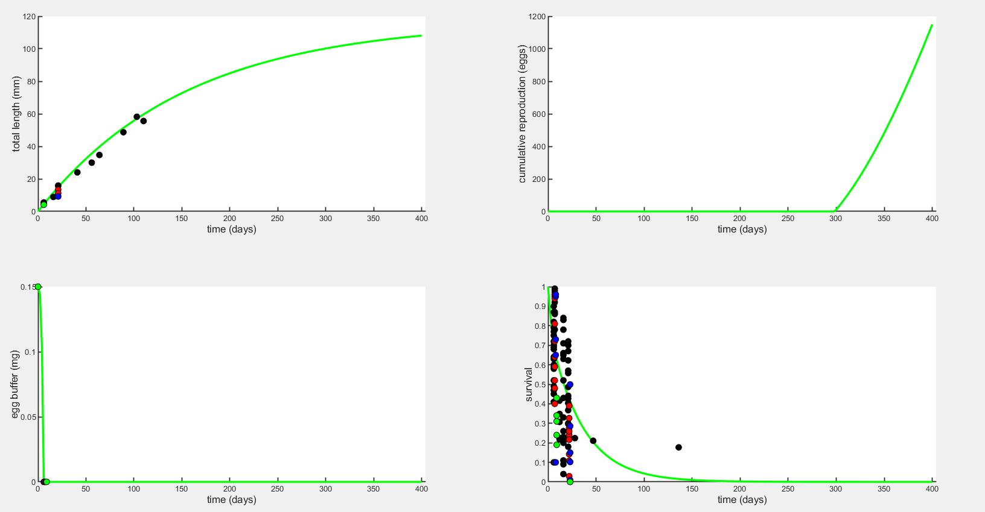
Plot to 400 days
Without hypoxia effect, the green line is control DO

Slide 3
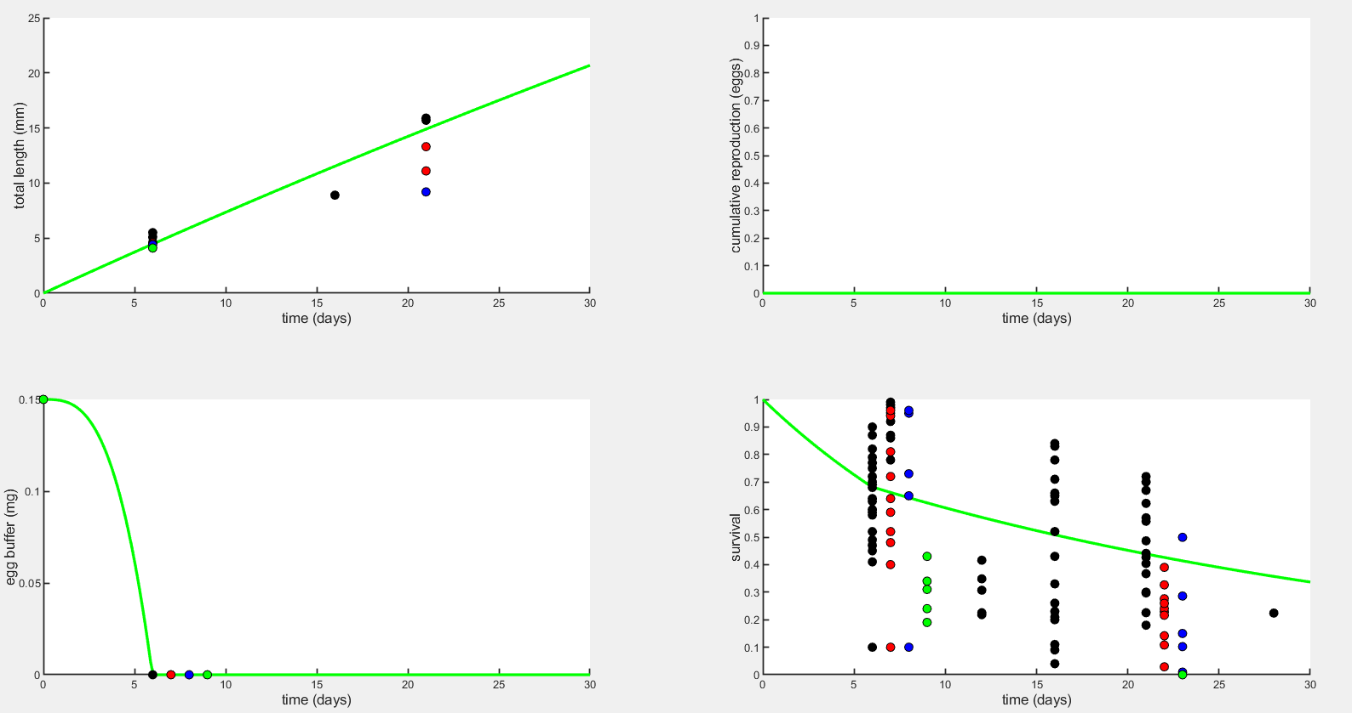
Plot to 30 days
Without hypoxia effect, the green line is control DO

Slide 4
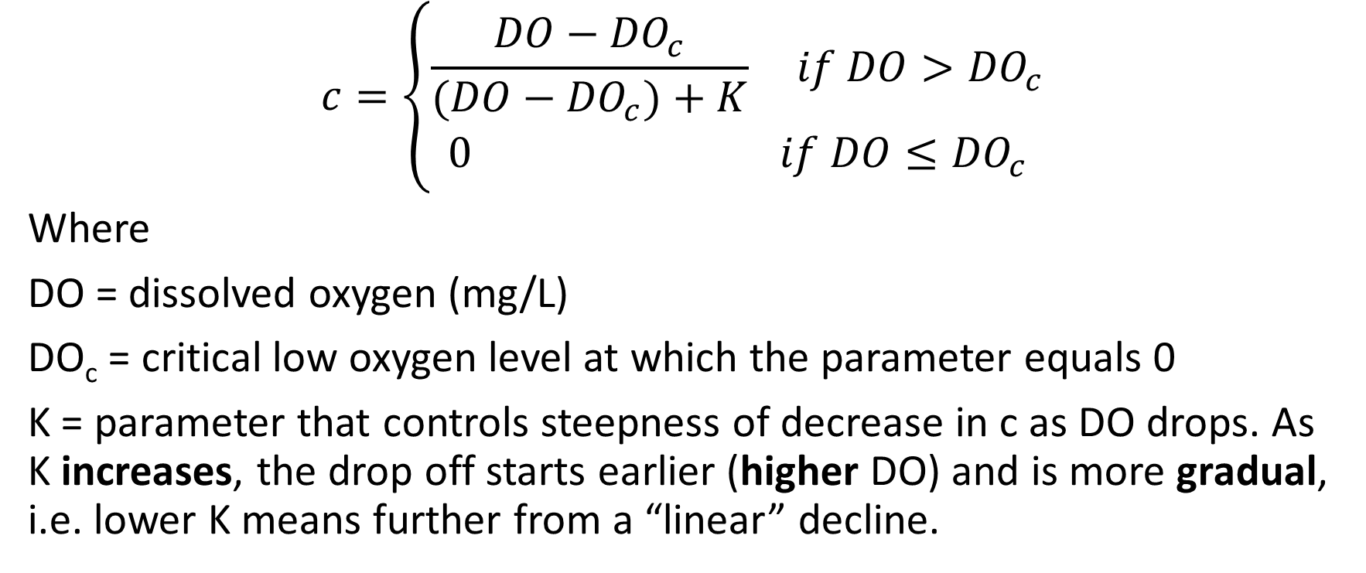
Stress function for Assimilation and Yield (Option 1)
$$c=\left\{\begin{aligned}\frac{DO−{DO}_{c}}{(DO−{DO}_{c})+K} if DO>{DO}_{c} \\ 0 if DO≤{DO}_{c}\end{aligned}\right.$$
Where
DO = dissolved oxygen (mg/L)
DO_{c} = critical low oxygen level at which the parameter equals 0
K = parameter that controls steepness of decrease in c as DO drops. As K increases, the drop off starts earlier (higher DO) and is more gradual, i.e. lower K means further from a “linear” decline.

Slide 5
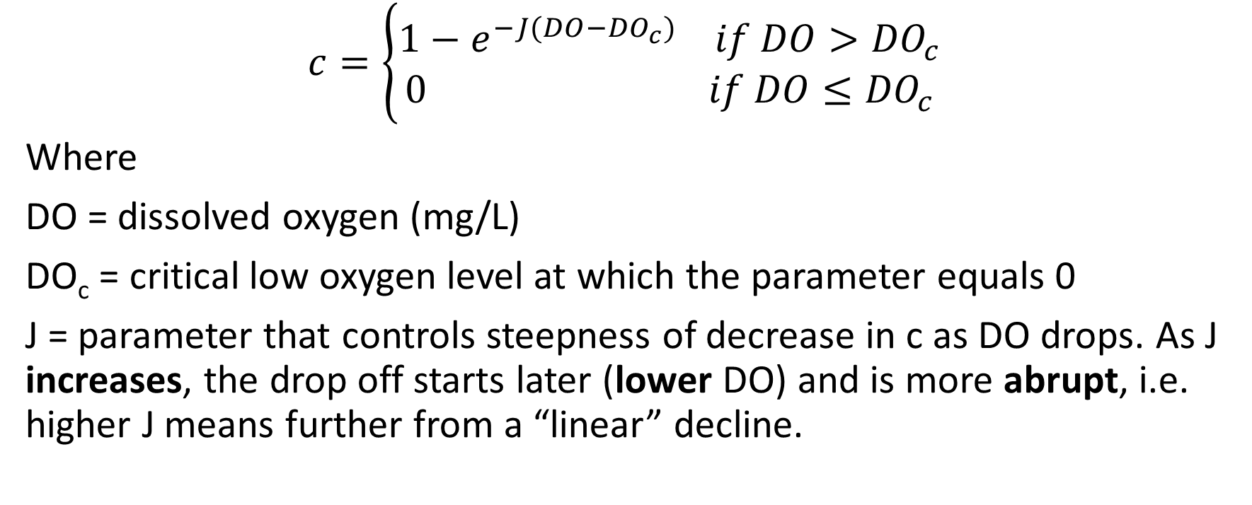
Stress function for Assimilation and Yield (Option 2)
$$c=\left\{\begin{aligned}1−e^{−J(DO−{DO}_{c})} if DO>{DO}_{c} \\ 0 if DO≤{DO}_{c}\end{aligned}\right.$$
Where
DO = dissolved oxygen (mg/L)
DO_{c} = critical low oxygen level at which the parameter equals 0
J = parameter that controls steepness of decrease in c as DO drops. As J increases, the drop off starts later (lower DO) and is more abrupt, i.e. higher J means further from a “linear” decline.

Slide 6
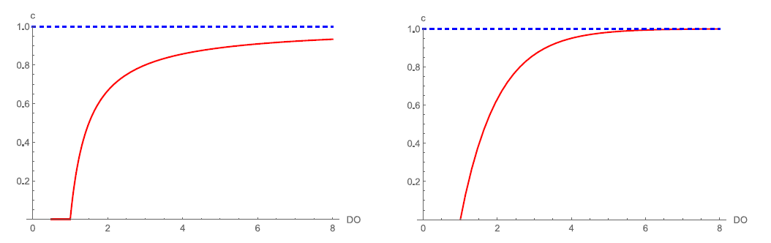
Assimilation and Yield Correction Factor
Option 1 Option 2

Slide 7
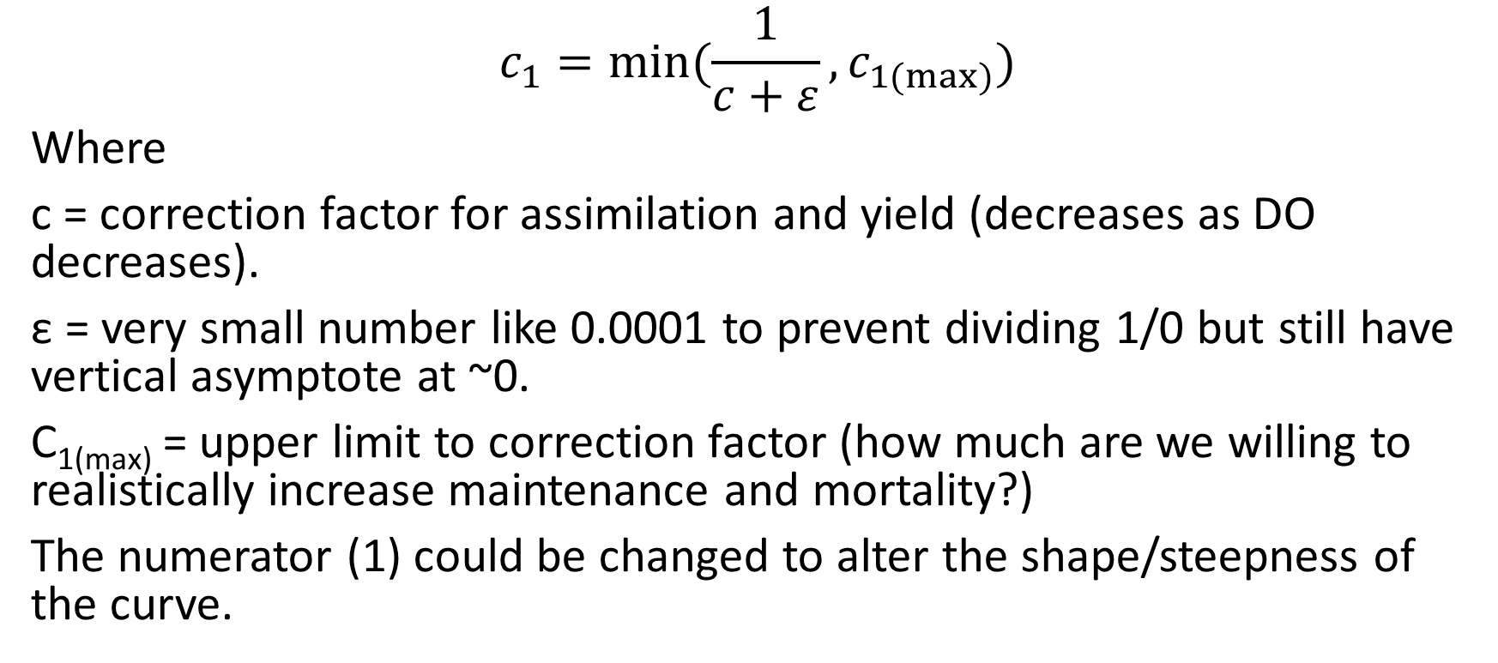
Stress function for Maintenance and Mortality
$$c_{1}=min⁡(\frac{1}{c+ε},c_{1(max⁡)})$$
Where
c = correction factor for assimilation and yield (decreases as DO decreases).
ε = very small number like 0.0001 to prevent dividing 1/0 but still have vertical asymptote at ~0.
C_{1(max)} = upper limit to correction factor (how much are we willing to realistically increase maintenance and mortality?)
The numerator (1) could be changed to alter the shape/steepness of the curve.

Slide 8
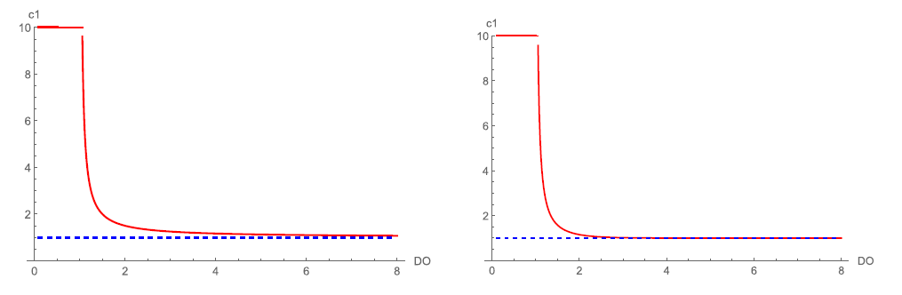
Maintenance and Mortality Correction Factor
Option 1 Option 2

Slide 9
Applying stress function to each parameter of interest
Parameter(s) affected by stress | Direction of effect | Best K | AIC | Best J | AIC | Notes
sJAm | ↓ | 2e-16 | 622.80 | 1.688 | 616.82 | Best fit version with K has no hypoxia effect. The value of DO_{c} affects the best estimate of J, with a lower DO_{c} leading to a lower J. There is also a local minimum around 0.5 but global minimum around 1.5.
yVA | ↓ | 2e-16 | 622.80 | 1.480 | 620.43 | Very similar to sJAm.
sJM | ↑ | 0.8119 | 615.64 | 0.3634 | 614.02 | Changing DO_{c} doesn’t affect the estimates very much, unlike sJAm and yVA. Length is the only thing affected. This successfully allows maintenance to change more.
mu_emb | ↑ | 0.9487 | 604.13 | 0.6334 | 602.55 | Only affects survival (of course), not length or egg buffer.
mu_lar | ↑ | 2.044 | 596.98 | 0.3275 | 593.66 | Post-hatch survival is able to get very close to the observed.
sJAm & sJM | ↓ & ↑ | 2e-16 | 622.80 | 0.5847 | 677.00 | Best fit gives too great of hypoxia effect.
yVA & sJM | ↓ & ↑ | 2e-16 | 622.81 | 1.511 | 618.38 | There is sometimes a local minimum around J=0.5 and a global minimum around J=1.5, detected by plotting loglik.
May need to set an upper bound where c=1 so that control has no hypoxia effect.
When working with sJAm and yVA the best fit doesn’t look that good to me.

Slide 10
Applying stress function to each parameter of interest
Parameter(s) affected by stress | Direction of effect | Best K | AIC | Best J | AIC | Notes
sJAm & mu_emb | ↑ & ↓ | 0 | 622.81 | 1.688 | 607.13 | A little weak of a hypoxia effect. When using K there was a local minimum that gave more reasonable results (K=0.28).
yVA & mu_emb | ↑ & ↓ | 2e-16 | 622.81 | 1.331 | 606.59 | Ditto. But the version using J gives pretty reasonable hypoxia effects.
mu_emb & mu_lar | ↑ & ↑ | 0.7062 | 599.53 | 0.7717 | 597.30
sJM & mu_emb | ↑ & ↑ | 0.8633 | 598.23 | 0.5069 | 599.58
sJAm & mu_lar | ↓ & ↑ | 2e-16 | 622.81 | 1.688 | 611.90 | When using J there was a local minimum at J=0.55.
yVA & mu_lar | ↓ & ↑ | 2e-16 | 622.81 | 1.371 | 611.49 | Ditto
sJM & mu_lar | ↑ & ↑ | 1.038 | 595.45 | 0.3582 | 585.76
sJAm & mu_lar & mu_emb | ↓&↑&↑ | 0 | 622.81 | 1.688 | 603.84
sJM & mu_lar & mu_emb | ↑&↑&↑ | 0.7430 | 592.68 | 0.7117 | 596.12
sJAm & sJM & mu_emb & mu_lar | ↓&↑&↑&↑ | 0 | 622.81 | 1.709 | 603.94

Slide 11
Plot legend
Black = 8 mg/L (control)
Red = 4 mg/L
Blue = 3 mg/L
Green = 2.5 mg/L

Slide 12
Mean data values for each DO treatment
This could be useful when viewing the plots and how well the predicted values fit (because for survival and length there are multiple data points on the plot).
 | 7.7 mg l⁻¹ | 4.2 mg l⁻¹ | 3.1 mg l⁻¹ | 2.7 mg l⁻¹
Survival to hatching | 74.3% (range 41-100%) | 70.6% (range 40-100%) | 85.8% (range 65-100%) | 30.2% (range 19-43%)
Hatch time (egg buffer=0) | 6 days | 7 days | 8 days | 9 days
Length at hatching | 5.3 mm | 4.55 mm | 4.4 mm | 4.1 mm
Larval length at 15 dph* | 15.8 mm | 12.2 mm | 9.2 mm | NA
Larval survival to 15 dph* | 44.0% (range 4-84%) | 22.2% (range 3-33%) | 20.9% (range 1-50%) | 0% (range 0-0%)
*15 days post hatching = 21-24 days post fertilization, because low oxygen delays hatching

Slide 13
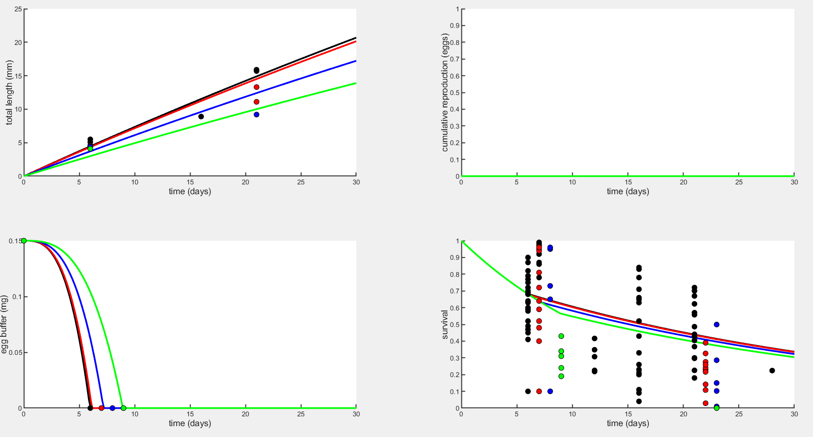
Early life plots – Assimilation (sJAm) with Option 2 (J=1.688)

Slide 14
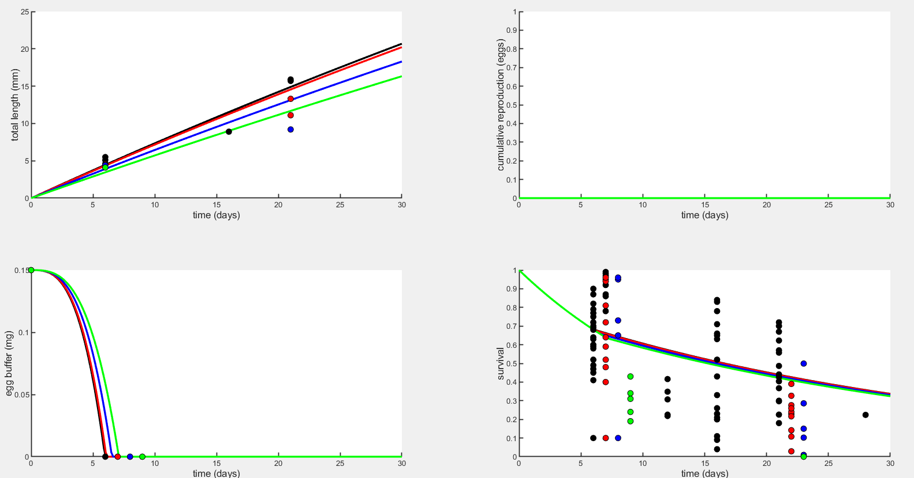
Early life plots – Yield coefficient for growth (yVA) with Option 2 (J=0.498).

Slide 15
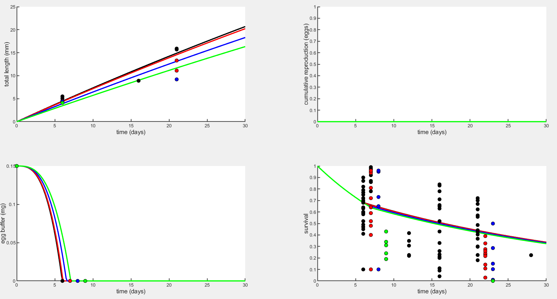
Early life plots – Yield coefficient for growth (yVA) with Option 2 (J=1.48, DO_{c}=1.7).

Slide 16
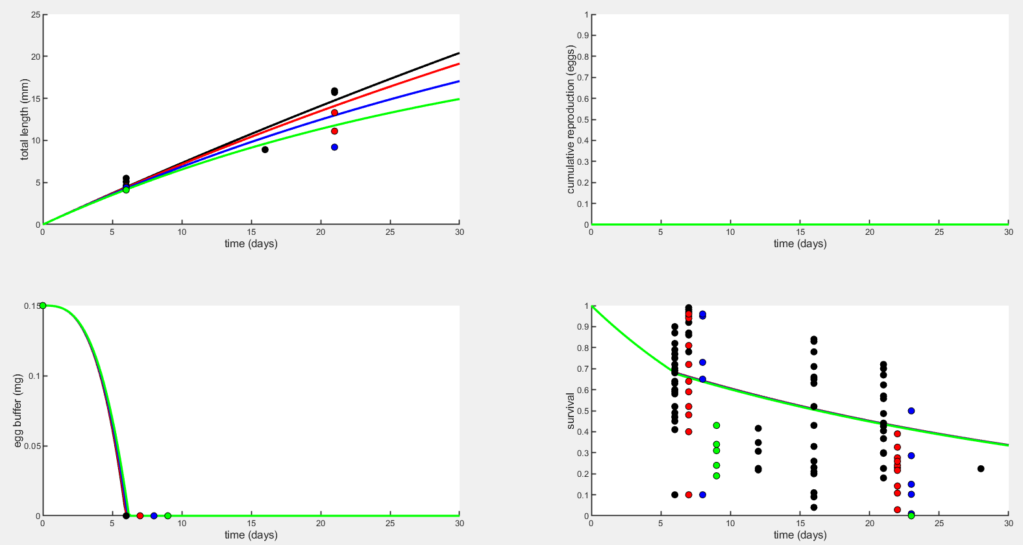
Early life plots – Maintenance (sJM) with Option 2 (J=0.36)

Slide 17
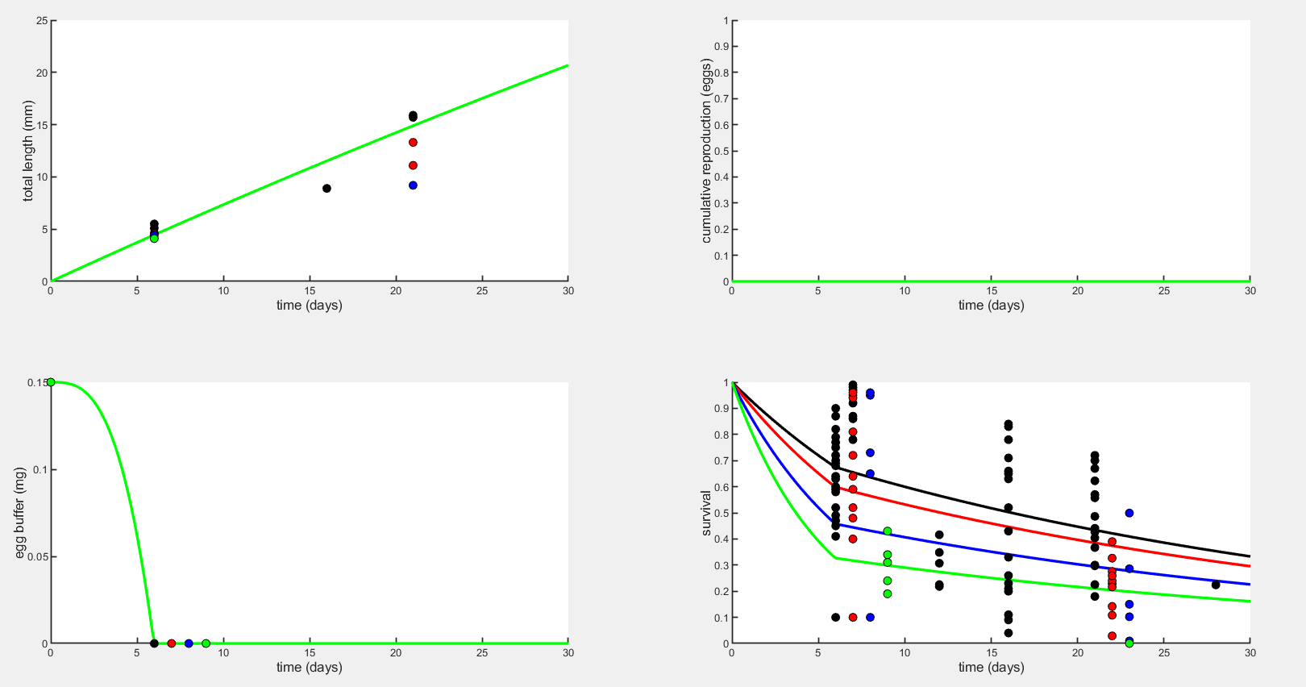
Early life plots – Embryo mortality (mu_emb) with Option 2 (J=0.63)

Slide 18
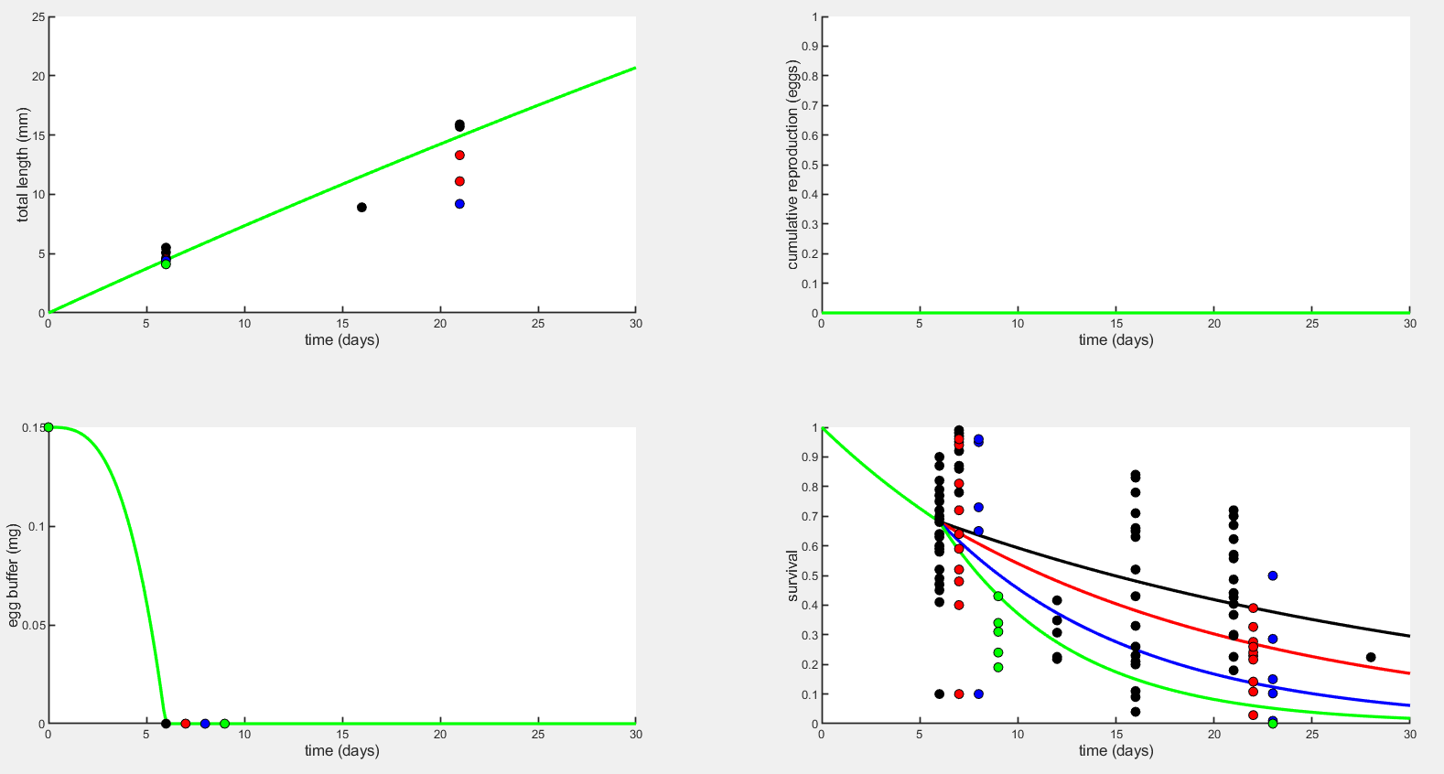
Early life plots – Larval mortality (mu_lar) with Option 2 (J=0.3275)

Slide 19
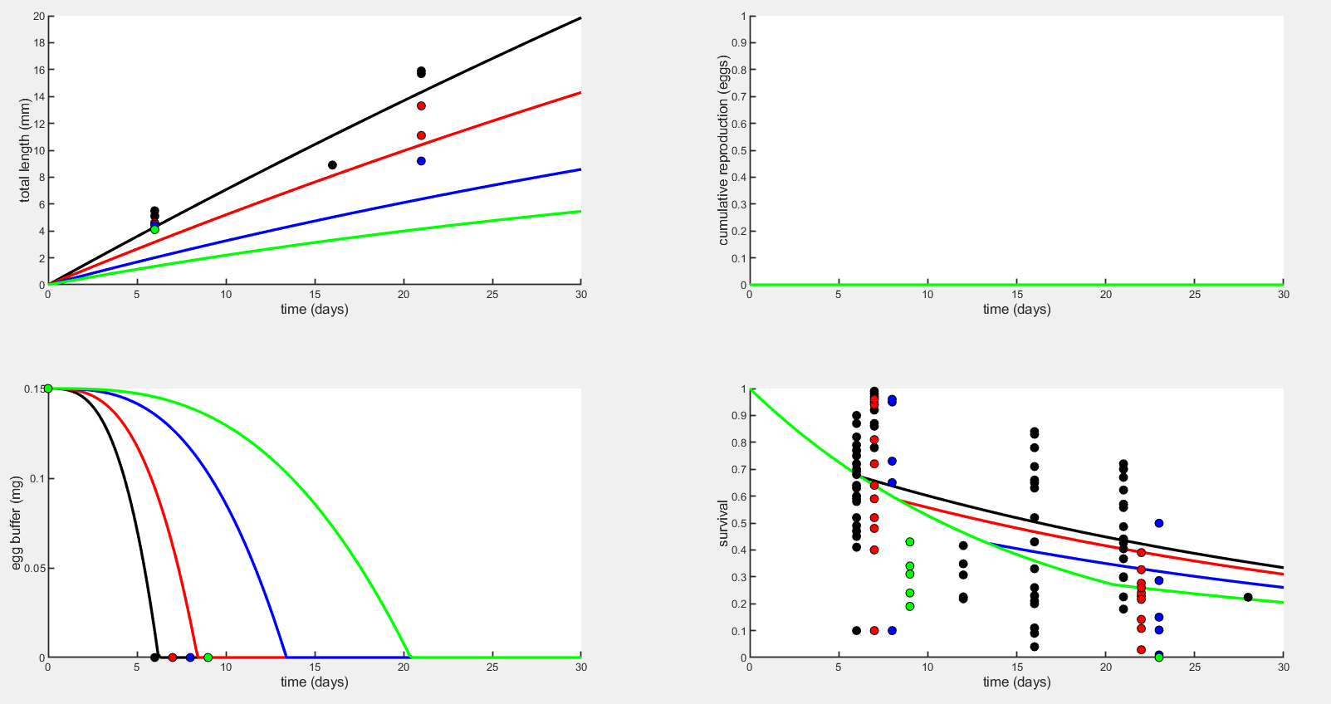
Early life plots – sJAm & sJM with Option 2 (J=0.58)

Slide 20
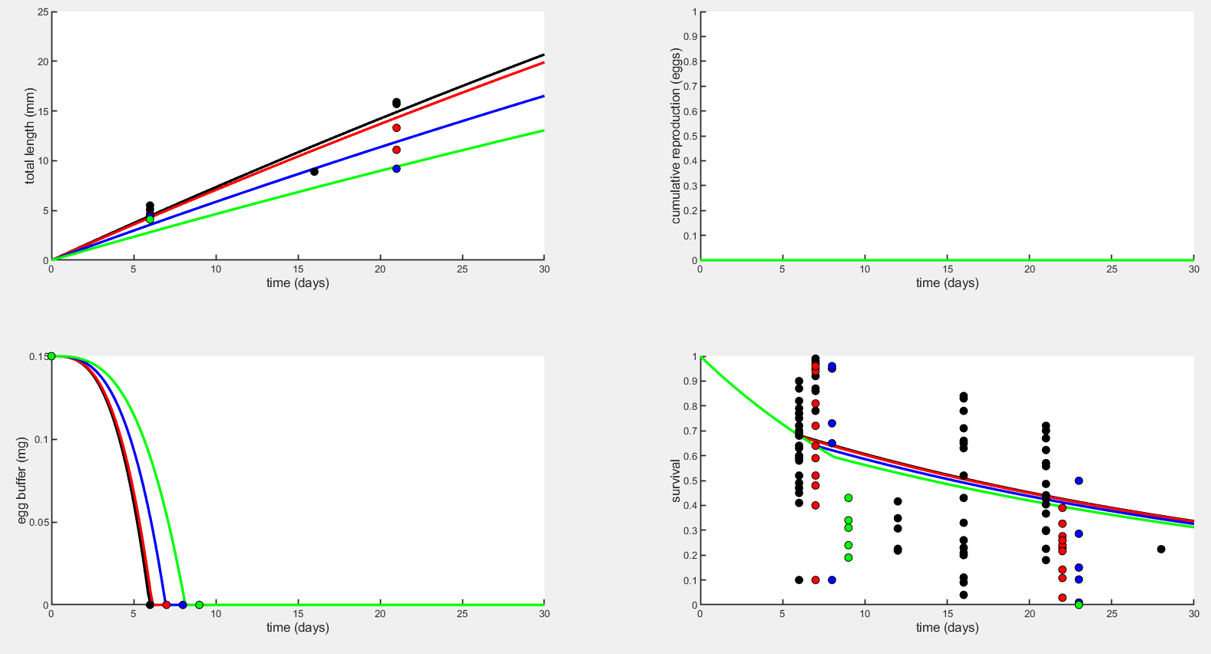
Early life plots – yVA & sJM with Option 2 (J=1.511)

Slide 21
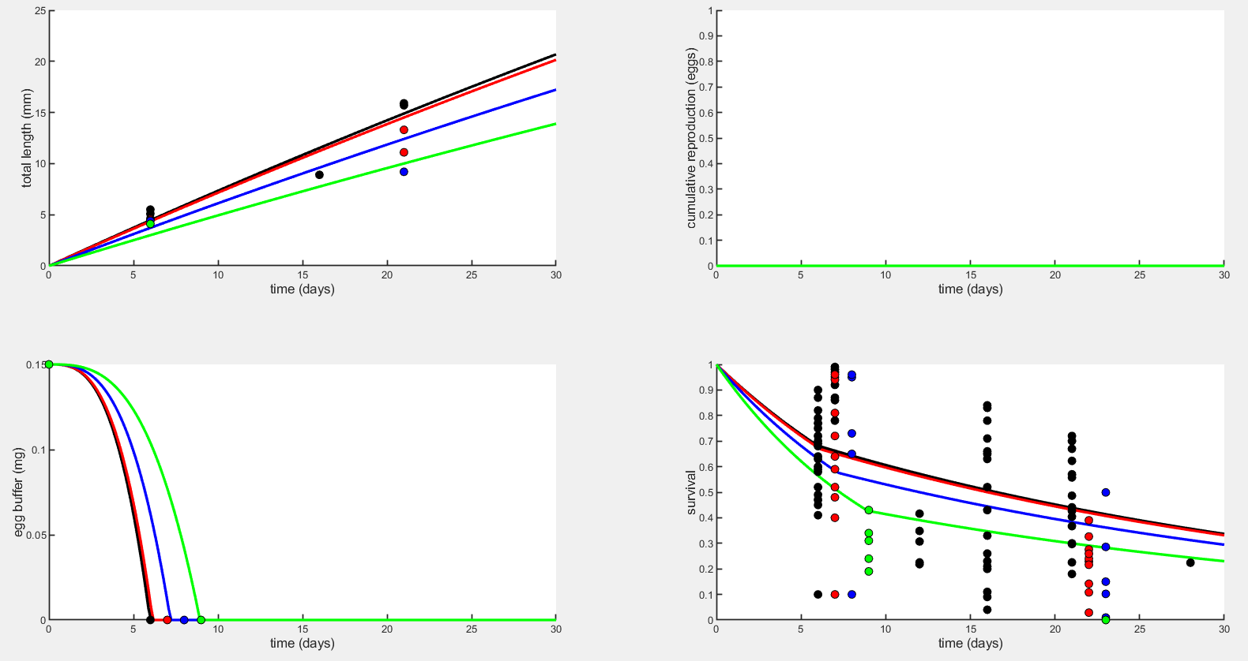
Early life plots – sJAm & mu_emb with Option 2 (J=1.688)

Slide 22
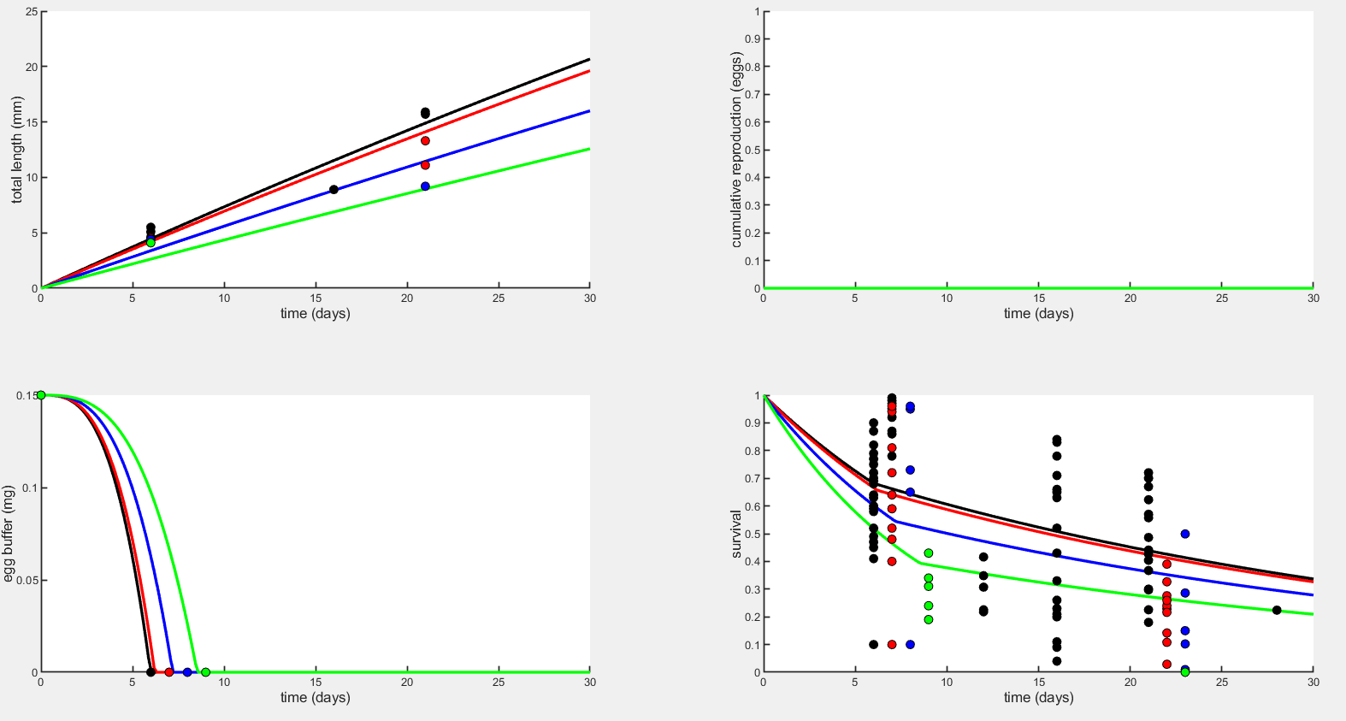
Early life plots – yVA & mu_emb with Option 2 (J=1.33)

Slide 23
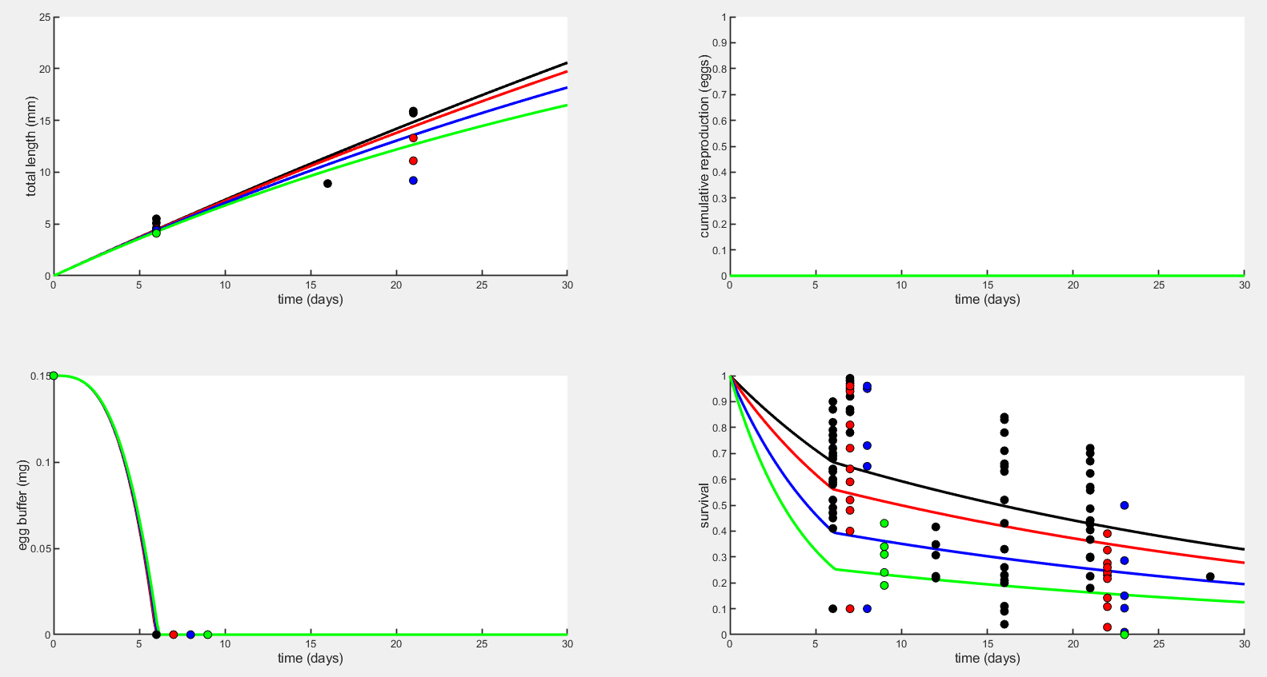
Early life plots – sJM & mu_emb with Option 1 (K=0.86)

Slide 24
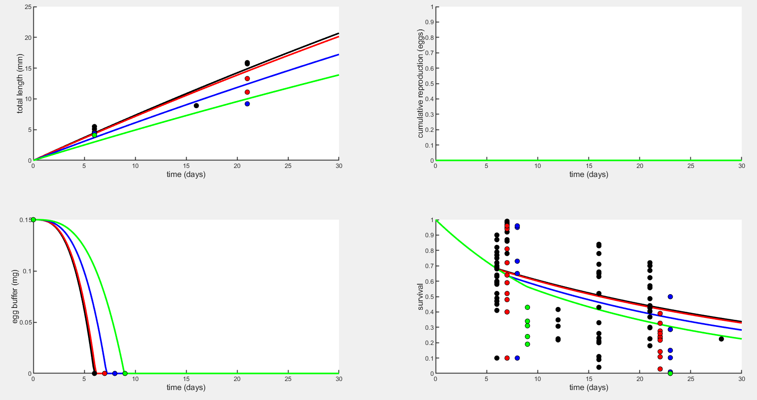
Early life plots – sJAm & mu_lar with Option 2 (J=1.688)

Slide 25
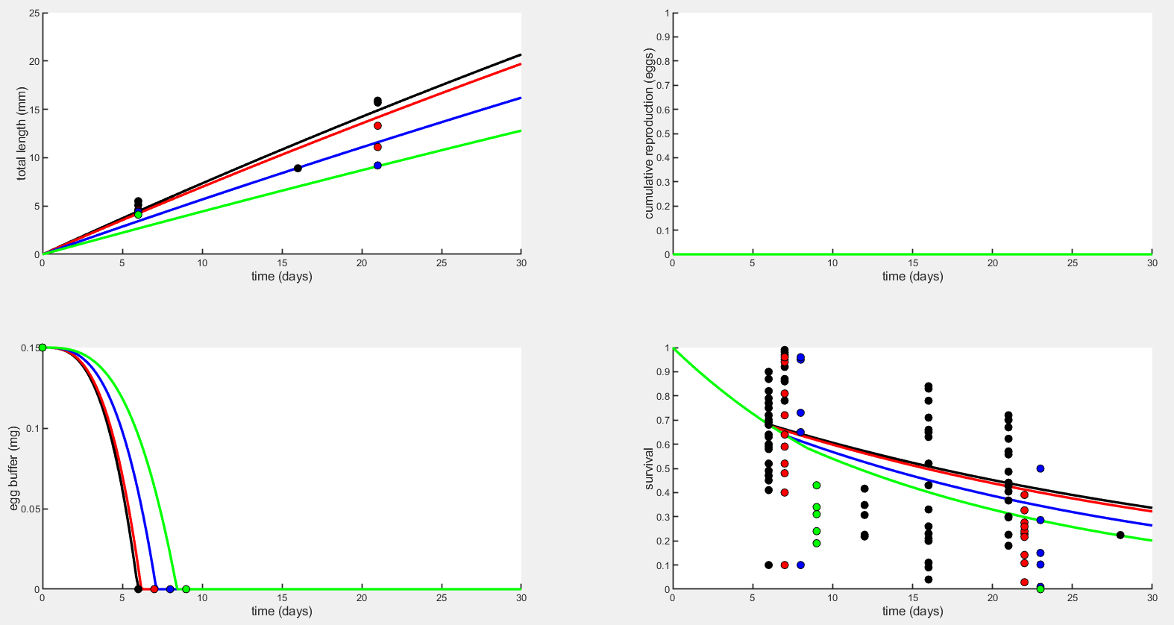
Early life plots – yVA & mu_lar with Option 2 (J=1.371)

Slide 26
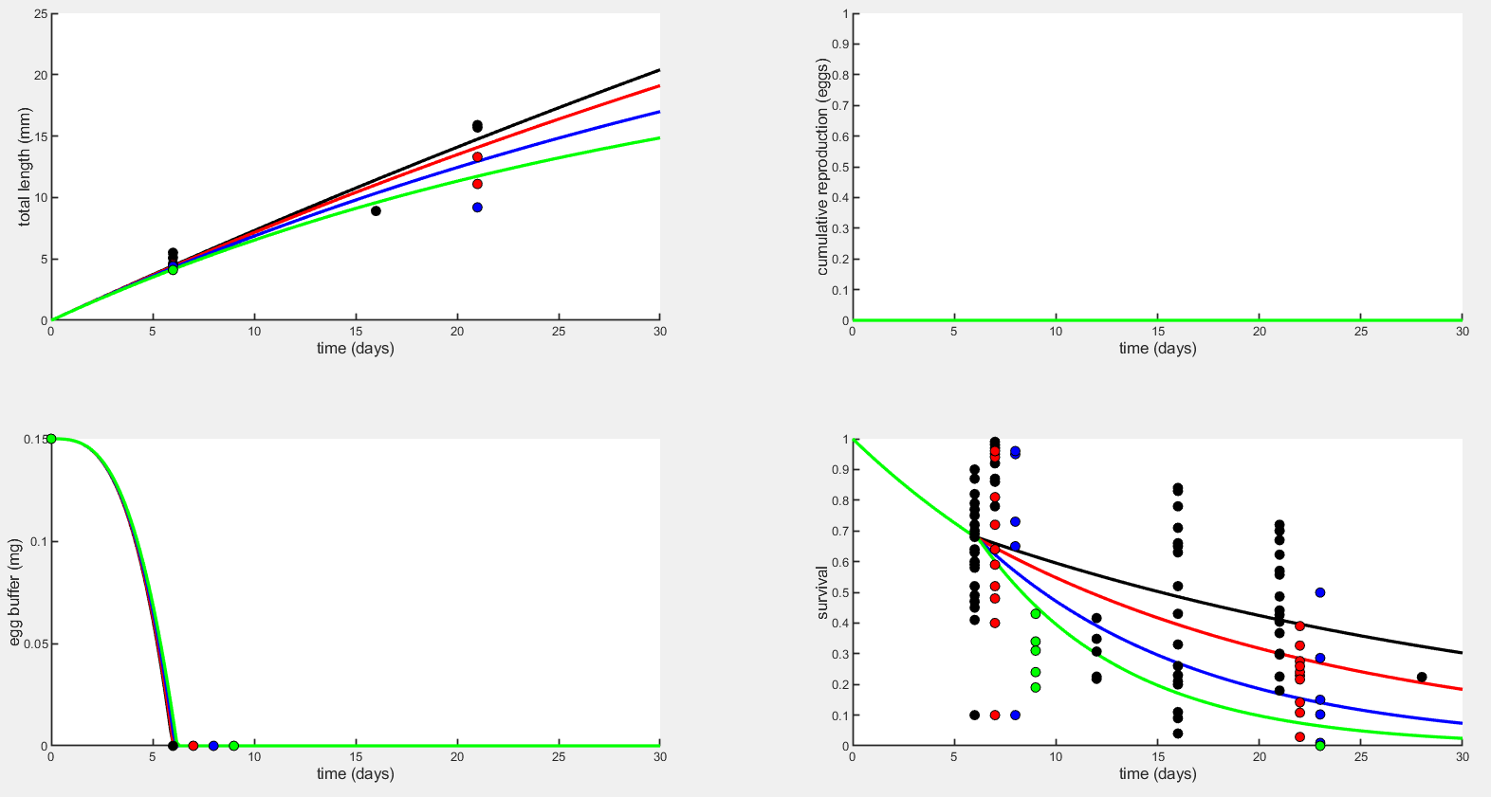
Early life plots – sJM & mu_lar with Option 2 (J=0.3582)

Slide 27
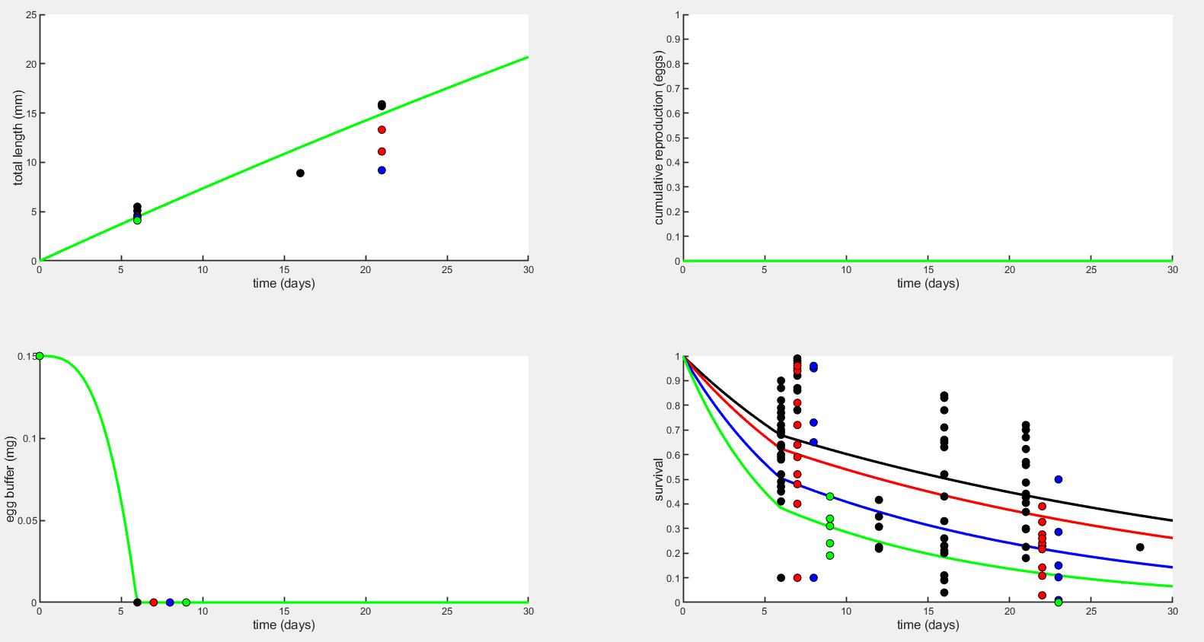
Early life plots – mu_emb & mu_lar with Option 2 (J=0.77)

Slide 28
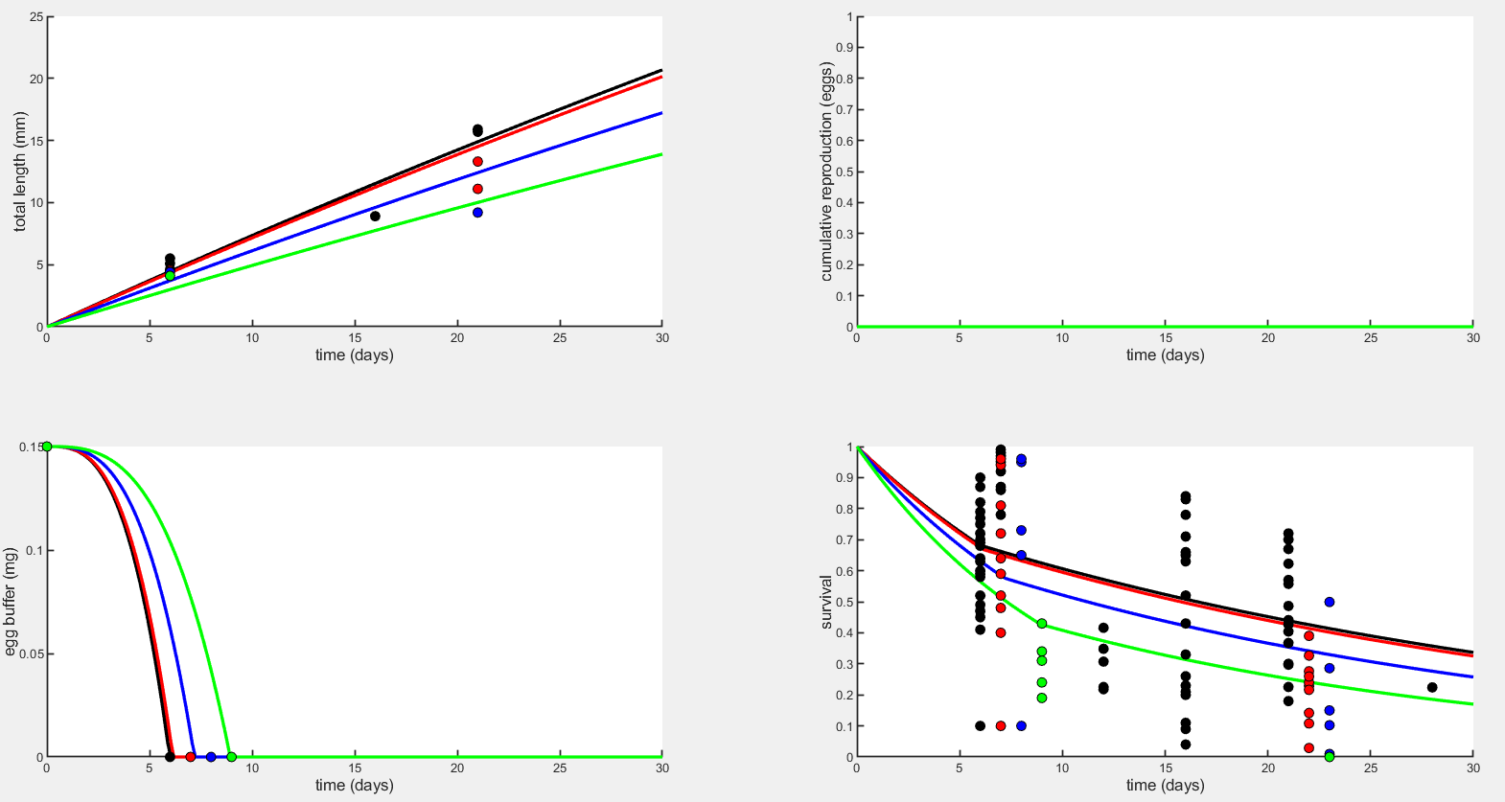
Early life plots – sJAm, mu_emb, & mu_lar with Option 2 (J=1.688)

Slide 29
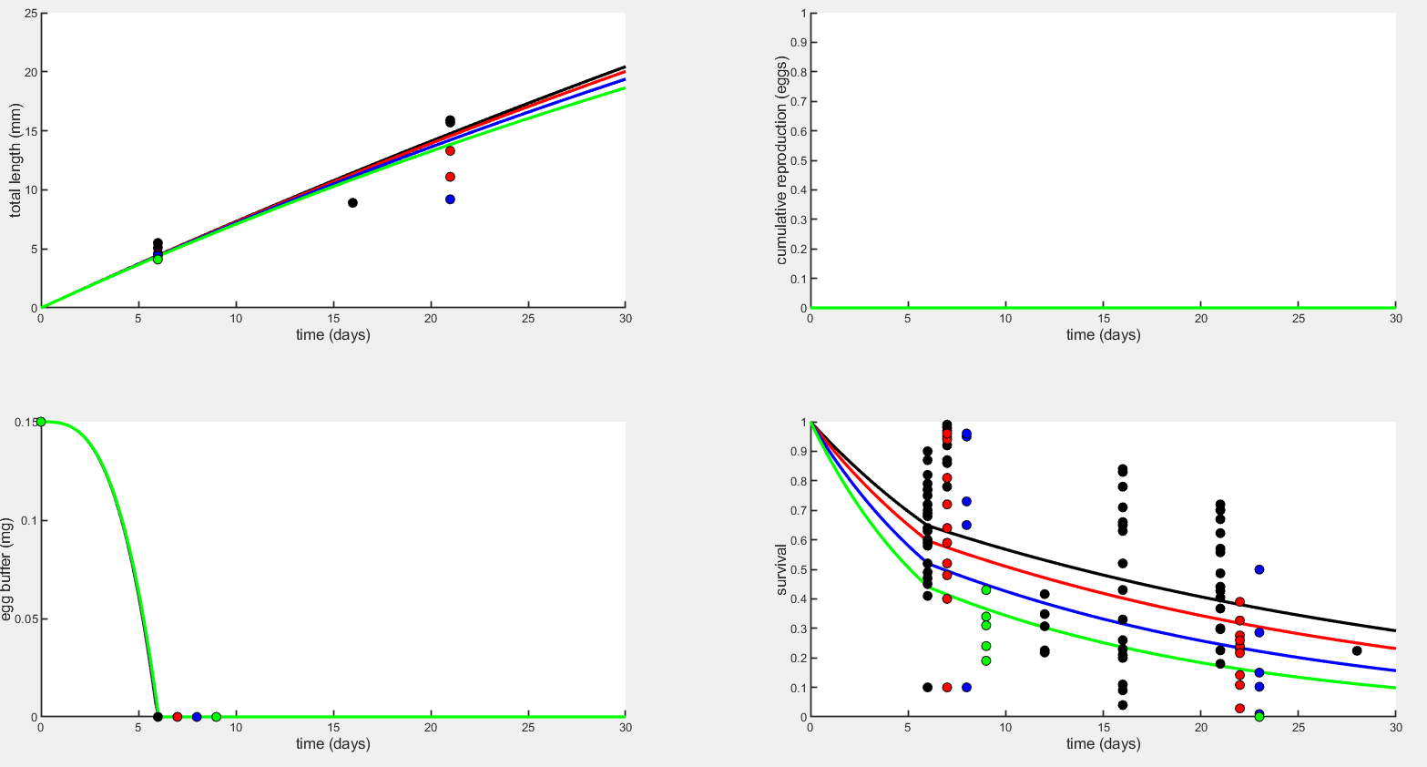
Early life plots – sJM, mu_emb, & mu_lar with Option 1 (K=0.74)

Slide 30
Early life plots – sJAm, sJM, mu_emb, & mu_lar with Option 2 (J=1.688)

